Slide 1
Pointers, Virtual Functions & Polymorphism

Slide 2
Introduction
Polymorphism is one of the crucial features of OOP.
It simply means 'one name, multiple forms’. Or multiple methods but only one interface.
Polymorphism – Assigning additional tasks to the existing things such as: Member functions, constructors and operators
The overloaded member functions are 'selected' for invoking by matching arguments, both type and number.
This information is known to the compiler at the compile time and, therefore, compiler is able to select the appropriate function for a particular call at the compile time itself.

Slide 3
Introduction
This is called early binding or static binding or static linking.
Also known as compile time polymorphism.
Early binding simply means that an object is bound to its function call at compile time.

Slide 4
Introduction
Consider a situation where the function name and prototype is the same in both the base and derived classes. For example
c1ass A
{
int x;
public:
void show()
{ ------- }
};
class B: public A
{
int y;
public:
void show()
{ ------- }
};
How do we use the member function show() to print the values of objects of both the classes A and B?
Since the prototype of show() is the same in both the places, the function is not overloaded and therefore static binding does not apply.
In such cases, scope resolution operator (::) can be used to specify the class while invoking the functions with the derived class objects.

Slide 5
Types of Polymorphism

Slide 6
Types of Polymorphism
There are two types of polymorphism:
Compile time polymorphism:
It is also known as static binding or early binding.
Run time polymorphism:
It is also known as dynamic binding or late binding.
Dynamic binding is one of the powerful feature of C++.
This requires the use of pointers and objects.

Slide 7
Run-Time Polymorphism
When the appropriate function is selected during execution, this is known as run time polymorphism.
A mechanism known as virtual function is used to achieve run time polymorphism
Depending upon the objects under consideration, the appropriate version of the function is invoked.
Since the function is linked with a particular class much later after the compilation. This process is termed as late binding or dynamic binding.
It is because the selection of the appropriate function is done dynamically at run time.

Slide 8
Run-Time Polymorphism
Dynamic binding is one of the powerful features of C++.
This requires the use of pointers to objects.
So let’s see how the object pointers and virtual functions are used to implement dynamic binding.

Slide 9
Pointers
Pointer is a derived data type that refers to another data variable by storing the variable's memory address rather than data.
A pointer variable defines where to get the value of a specific data variable instead of defining actual data.
Declaration of a pointer:
data-type *ptr-var
Here, ptr-var is the name of the pointer, and data-type refers to one of the valid
C++ data types.
The data-type is followed by an asterisk (*) symbol, which distinguishes a pointer variable from other variables to the compiler

Slide 10
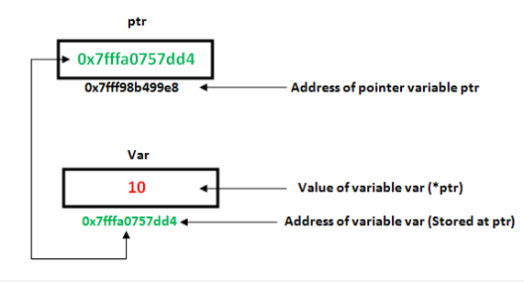
Pointers

Slide 11
Using Pointers
#include<iostream>
using namespace std;
int main()
{
int var = 20;
int *ptr;
ptr = &var;
cout << "Value at ptr = " << ptr << "\n";
cout << "Value at var = " << var << "\n";
cout << "Value at *ptr = " << *ptr << "\n";
}

Slide 12
Pointer to Pointer
A pointer variable can point to another pointer.
i.e, A pointer variable contains address of another pointer.
int main()
{
int a, *ptrl, **ptr2;
ptrl = &a;
ptr2 = &ptrl;
cout<<"\nAddress of a: "<<ptrl;
cout<<"\nAddress of ptr1: "<<ptr2;
ptrl += 2;
cout<<"\nptr1 after increment by a factor of 2 : "<<ptrl;
ptr2++;
cout<<"\nptr2 after increment by a factor of 1 : "<<ptr2;
}

Slide 13
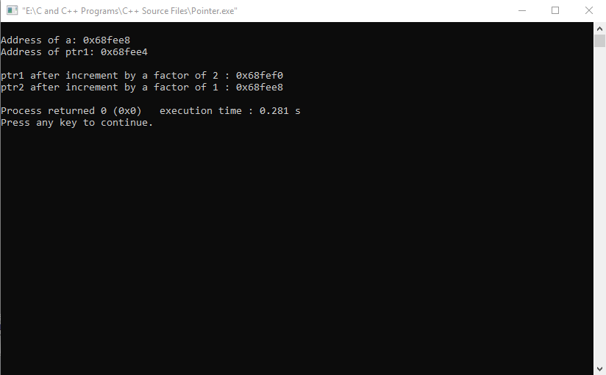
Pointer to Pointer

Slide 14
Pointer to Objects
A pointer can point to an object created by a class.
For Example,
item x;
where item is a class and x is an object defined to be of type item.
Similarly, we can define a pointer ptrx of type item as follows:
item *ptrx;
Object pointers are useful in creating objects at run time.
An object pointer can be used to access the public members of an object.

Slide 15
Pointer to Objects
class myclass {
int x;
public: void get (int j) {
x = j;
}
int getint() { return x;
} };
int main() { myclass obj, *objPtr;
objPtr = &obj; // Get address of obj objPtr -> get(10);
cout<< objPtr -> getint();
}

Slide 16
int main() { item *p = new item[3]; item *ptr = p; int x, i; float y; for(i=1; i<=3; i++) { cout<<“Enter code & price: "<<i; cin>>x>>y; ptr->getdata(x, y); ptr++; } ptr = p; for(i=1; i<=3; i++) { cout<<"\nItem: "<<i; (*ptr).show(); // OR ptr->show(); ptr++; } delete p; }
Program to demonstrate Pointer to Objects
class item
{
int code;
float price;
public:
void getdata(int c, float p)
{
code = c;
price = p;
}
void show()
{
cout<<“code: "<<code;
cout<<“Price: "<<price;
}
};

Slide 17
this Pointer
C++ uses a unique keyword called this to represent an object that invokes a member function.
A special pointer that points to the object for which this function was called.
E.g: The Function call - A.max() - Sets the pointer this to the address of the object A
Starting address of object is same as the address of the first member in class
this pointer is automatically passed to a member function when it is called.
this pointer acts as an implicit argument to all the member functions.

Slide 18
Example of this Pointer
class ABC
{
int a;
----------
----------
};
The private variable 'a' can be used directly inside a member function, like
a = 123;
The following statement can also be used to do the same job:
this->a=123;

Slide 19
void Display() { cout<<"\n\tRoll No : "<<roll; cout<<"\n\tName : "<<name; cout<<"\n\tMarks : "<<marks; } }; int main() { Student S1(1, 89.63, “Akshit"); Student S2("Deepak", 78.53, 2); Student S3(3, "Rohit", 68.94); cout<<"\nDetails of Student 1 : "; S1.Display(); cout<<"\n\nDetails of Student 2 : "; S2.Display(); cout<<"\n\nDetails of Student 3 : "; S3.Display(); }
Program to Demonstrate the use of this Pointer
class Student
{
int roll;
char name[25];
float marks;
public:
Student(int rollno, float mks, char nam[])
{
roll = rollno;
strcpy(name, nam);
marks = mks;
}
Student(char nam[], float mks, int rollno)
{
roll = rollno;
strcpy(name, nam);
marks = mks;
}
Student(int rollno, char nam[], float mks) { this->roll = rollno; strcpy(this -> name, nam); this->marks = mks; }
Overloaded Constructors

Slide 20
int main() { person p1("John", 37.50), p2(“Alice", 29.0), p3(“Robert", 40.25); person p = p1.greater(p3); cout<<"Elder person is: "; p.display(); p = p1.greater(p2); cout<<"Elder person is: "; p.display(); }
Program to Demonstrate the use of this Pointer
class person
{
char name[20];
float age;
public:
person(char *s, float a)
{
strcpy(name, s);
age = a;
}
person& greater(person &x)
{
if(x.age >= age)
return x;
else
return *this;
}
void display()
{
cout<<"\tName: "<<name<<endl;
cout<<"\tAge: "<<age<<endl;
}
};

Slide 21
Pointer to Derived Class
Pointers not only can point to the base objects, they can also point to the objects of derived classes.
Pointers to objects of base class are type-compatible with the pointers to objects of derived class.
Thus, a single pointer can be made to point to objects belonging to different classes.
For example: If B is a base class and D is a derived class from B, then a pointer declared as pointer to B can also be a pointer to D.
B *ptr; // pointer to class B type variable
B b; // base object
D d; // derived object
ptr = &b; // ptr points to object b
ptr can also point to the object d as follows:
ptr = &d; // ptr points to object d

Slide 22
Pointer to Derived Class
Problem with Base Pointer:
There is a problem in using ptr to access the public members of the derived class D.
Using ptr, we can access, only those members which are inherited from B and not the members that originally belong to D.
In case, a member of D has same name as one of the members of B, then any reference to that member by ptr will always access the base class member.
Although C++ permits a base pointer to point to any object derived from that base, the pointer cannot be directly used to access all the members of the derived class.
We may have to use another pointer declared as pointer to the derived type.

Slide 23
int main() { Base B, *BasePtr; BasePtr = &B; BasePtr -> b = 100; BasePtr -> show(); Derived D; BasePtr = &D; BasePtr -> b = 200; // *BasePtr -> d = 300; // won‘t work BasePtr -> show(); // Accesses only inherited // Base members Derived *DerivedPtr; DerivedPtr = &D; DerivedPtr -> d = 300; DerivedPtr -> show(); cout <<"Using ((Derived *) BasePtr)\n"; ((Derived *) BasePtr) -> d = 400; ((Derived *) BasePtr) -> show(); }
Program to Demonstrate Pointer to Derived Class
class Base
{
public:
int b;
void show()
{
cout<<"\nb = "<<b;
}
};
class Derived: public Base
{
public:
int d;
void show()
{
cout<<"\nb = "<<b;
cout<<"\nd = "<<d;
}
};

Slide 24
Virtual Function
Polymorphism refers to the property by which objects belonging to different classes are able to respond to the same message, but in different forms.
Requirement of Polymorphism:
The ability to refer to objects regardless of their classes.
This requires the use of a single pointer to refer to the objects of different classes.
Here, we use the pointer to base class to refer to all the derived objects.
But, we just discovered that a base pointer, even when it is made to contain the address of a derived class, always executes the function in the base class.
The compiler simply ignores the contents of the pointer and chooses the member function that matches the type of the pointer.
Q: How run-time polymorphism can be achieved?
It is achieved using what is known as Virtual functions.

Slide 25
Virtual Functions
This is where the virtual function comes into picture.
When the same function name is used in both the base and derived classes, the function in base class is declared as virtual using the keyword virtual preceding its normal declaration.
When a function is made virtual, the compiler determines which function to use at run time based on the type of object pointed to by the base pointer, rather than the type of the pointer.
In this way, by making the base pointer to point to different objects, we can execute different versions of the virtual function.
This is called Function Overriding.

Slide 26
int main() { Base B, *Bptr; Bptr = &B; Bptr -> display(); Bptr -> show(); Derived D; Bptr = &D; Bptr -> display(); Bptr -> show(); }
Program to Demonstrate the use of Virtual Functions
Example-1
Run-Time Polymorphism
class Base
{
public:
void display()
{
cout<<"\n\nBase Class - display()";
}
virtual void show()
{
cout<<"\n\nBase Class - show()";
}
};
class Derived : public Base
{
public:
void display()
{
cout<<"\n\nDerived Class - display()";
}
void show()
{
cout<<"\n\nDerived Class - show()\n";
}
};

Slide 27
Example-2
Program to implement Run-Time Polymorphism using Virtual Fn.
class shape
{
public:
virtual float area(float, float)
{ }
};
class circle: public shape
{
float area(float pi, float r)
{
return(pi*r*r);
}
};
class rectangle: public shape
{
float area(float l, float b)
{
return(l*b);
}
};
int main()
{
shape *S1, *S2;
circle C;
rectangle R;
S1 = &C;
S2 = &R;
cout<<"\nArea of Circle = ";
cout<<S1->area(3.14, 5);
cout<<"\nArea of Rectangle = ";
cout<<S2->area(9.5, 4.3);
}
Here, ‘shape’ is an abstract class.

Slide 28
Rules for Virtual Functions
To implement late binding using virtual functions, some basic rules must be used:
Virtual functions must be the members of some class.
They cannot be static members.
They are accessed by using object pointers.
A virtual function can be a friend of another class.
A virtual function in a base class must be defined, even if it may not be used.
The prototypes of the base class version of a virtual function and all the derived class versions must be identical.
If two functions with the same name have different prototypes, C++ considers them as overloaded functions, and the virtual function mechanism is ignored.

Slide 29
Rules for Virtual Functions
We cannot have virtual constructors, but we can have virtual destructors.
While a base pointer can point to any type of the derived object, the reverse is not true. i.e., we cannot use a pointer to a derived class to access an object of the base type.
When a base pointer points to a derived class, incrementing or decrementing it will not make it to point to the next object of the derived class. It is incremented or decremented only relative to its base type. Thus, we should not use this method to move the pointer to the next object.
If a virtual function is defined in the base class, it is not necessary to redefine it in the derived class. In such cases, calls will invoke the base function.
Notes:
Virtual Destructor: Deleting a derived class object using a pointer to a base class that has a non-virtual destructor results in undefined behavior. To correct this situation, the base class should be defined with a virtual destructor.

Slide 30
Pure-Virtual Function
It is normal practice to declare a function virtual inside the base class and redefine it in the derived classes.
The function inside the base class is seldom used for performing any task.
It only serves as a placeholder.
E.g., In the last program, no object of class ‘shape’ was created and therefore the function area() in the base class has been defined 'empty’.
Such functions are called "do-nothing" functions.
A "do-nothing" function may be defined as follows:
virtual void display() = 0;

Slide 31
Pure-Virtual Function
Such functions are called Pure-Virtual functions.
A pure virtual function is a function declared in a base class that has no definition relative to the base class.
In such cases, the compiler requires each derived class to either define the function or re-declare it as a pure virtual function.
Remember that a class containing pure virtual functions cannot be used to create any objects of its own. Such classes are called abstract base classes.
The main objective of an abstract base class is to provide some traits to the derived classes and to create a base pointer required for achieving run time polymorphism.

Slide 32
Program to implement Run-Time Polymorphism using Pure-Virtual Fn.
class shape
{
public:
virtual float area(float, float) = 0;
};
class circle: public shape
{
float area(float pi, float r)
{
return(pi*r*r);
}
};
class rectangle: public shape
{
float area(float l, float b)
{
return(l*b);
}
};
int main()
{
shape *s[2];
circle C;
rectangle R;
s[0] = &C;
s[1] = &R;
cout<<"\nArea of Circle = ";
cout<<s[0]->area(3.14, 5);
cout<<"\nArea of Rectangle = ";
cout<<s[1]->area(9.5, 4.3);
}

Slide 33
Thanks

